Slide 1
BURNBRAE FARM WOODLAND CREATION PROPOSALS
Savills, on behalf of the landowners, are developing woodland creation proposals at Burnbrae
Walker Hines Woodland Services have been employed as agents to produce the proposals
Our aim is to produce woodland proposals which protect existing features of cultural, ecological and landscape value, and which meet the objectives of the owner
Objectives
Timber production in the medium and long-term
To combat climate change through carbon sequestration
Protecting and enhancing existing biodiversity values
Creating an attractive woodland which protects and enhances
existing recreational routes

Slide 2
Context
The UK imports over 70% of its timber needs.
Both the UK and Scottish Government supports woodland creation as a vital part of future land use in Scotland. This will contribute to: -
Meeting targets on Climate Change
carbon sequestration – targets are reviewed annually, with a target of 18,000 ha of new woodland in 2024/25
roughly 18% of Scotland is wooded, with a national target of 21% by 2032
Fulfilling targets on Biodiversity
Underpinning a Sustainable Supply of Wood Products to the Scottish forestry industry
In terms of the Ayrshire & Arran Forestry and Woodland Strategy, the locality is classified as being ‘preferred’ for and having ‘potential’ for a range of woodland types.
The project will be progressed through the Forestry Grant Scheme and submitted to Scottish Forestry for their approval.

Slide 3
Design & Application Process
Specialist Surveys carried out
Design of Woodland Creation Proposals
Draft Proposals
Pre-Application engagement
Site Survey
Gather feedback & review proposals as necessary
Scoping
After the application assessment, a 28 day formal consultation period will be run
Application Review & Formal Consultation, including Public Register
Scottish Forestry
Implementation of Woodland Planting & Management Proposals
Reviewed Proposals
Application Submission to Scottish Forestry
Approval

Slide 4
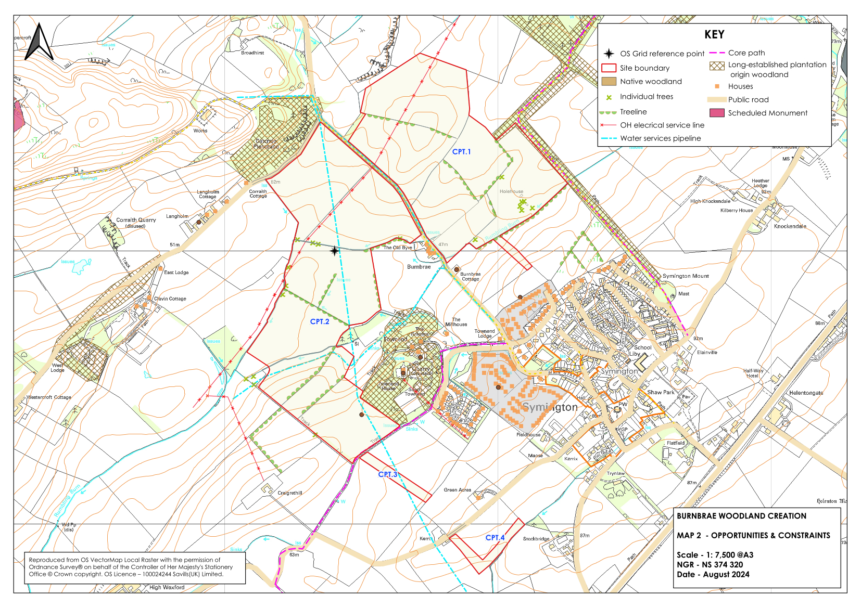
Opportunities & Constraints

Slide 5
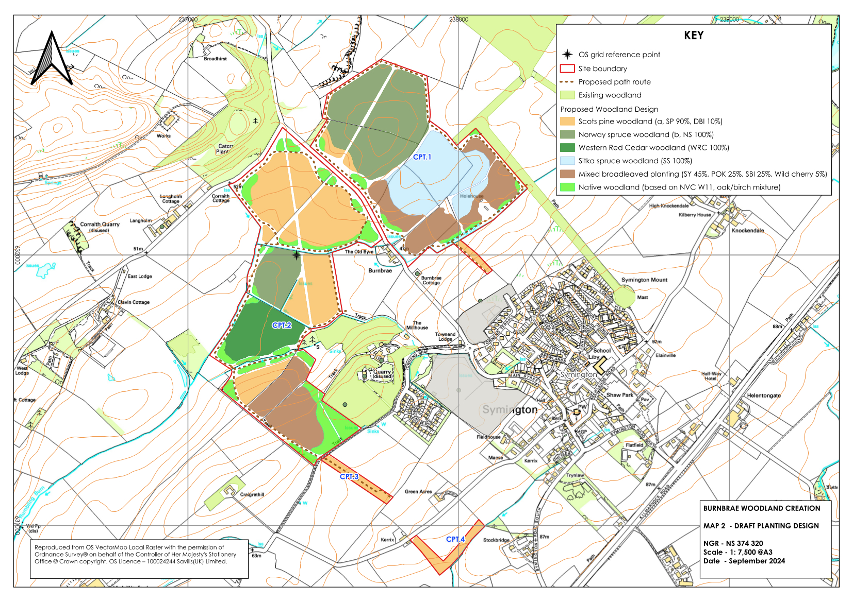
Draft Design

Slide 6
Design Considerations
Burnbrae
Planting held back from the edges of local roads
Sensitive habitats and historic features will be protected and retained in open ground
A mixture of woodland types, with coniferous woodland in suitable locations and native broadleaves focused to buffer ancient woodland remnants and to protect watercourses
Planting will include at least 4 coniferous species and 10 native broadleaved species all suited to the site-specific conditions
24% of the site will be planted with Broadleaves, 56% planted with conifers and 20% will remain as open ground

Slide 7
Design Considerations
Burnbrae
Native broadleaved woodland types will be matched to those in neighbouring woodlands to provide habitat and visual links
The planting will be protected by deer fencing carefully sited close to the woodland edge with self-closing pedestrian gates. This will avoid the need for individual tree shelters
Mown grass paths will link to existing nearby recreational routes
There may be opportunities for community planting events if there is local interest
There will be opportunities to use the site for education and study for local school children
Any timber extraction (year 35-40) would be north / west and will not go through the village. This will be controlled by the South Ayrshire Council who may introduce specific conditions to be observed

Slide 8
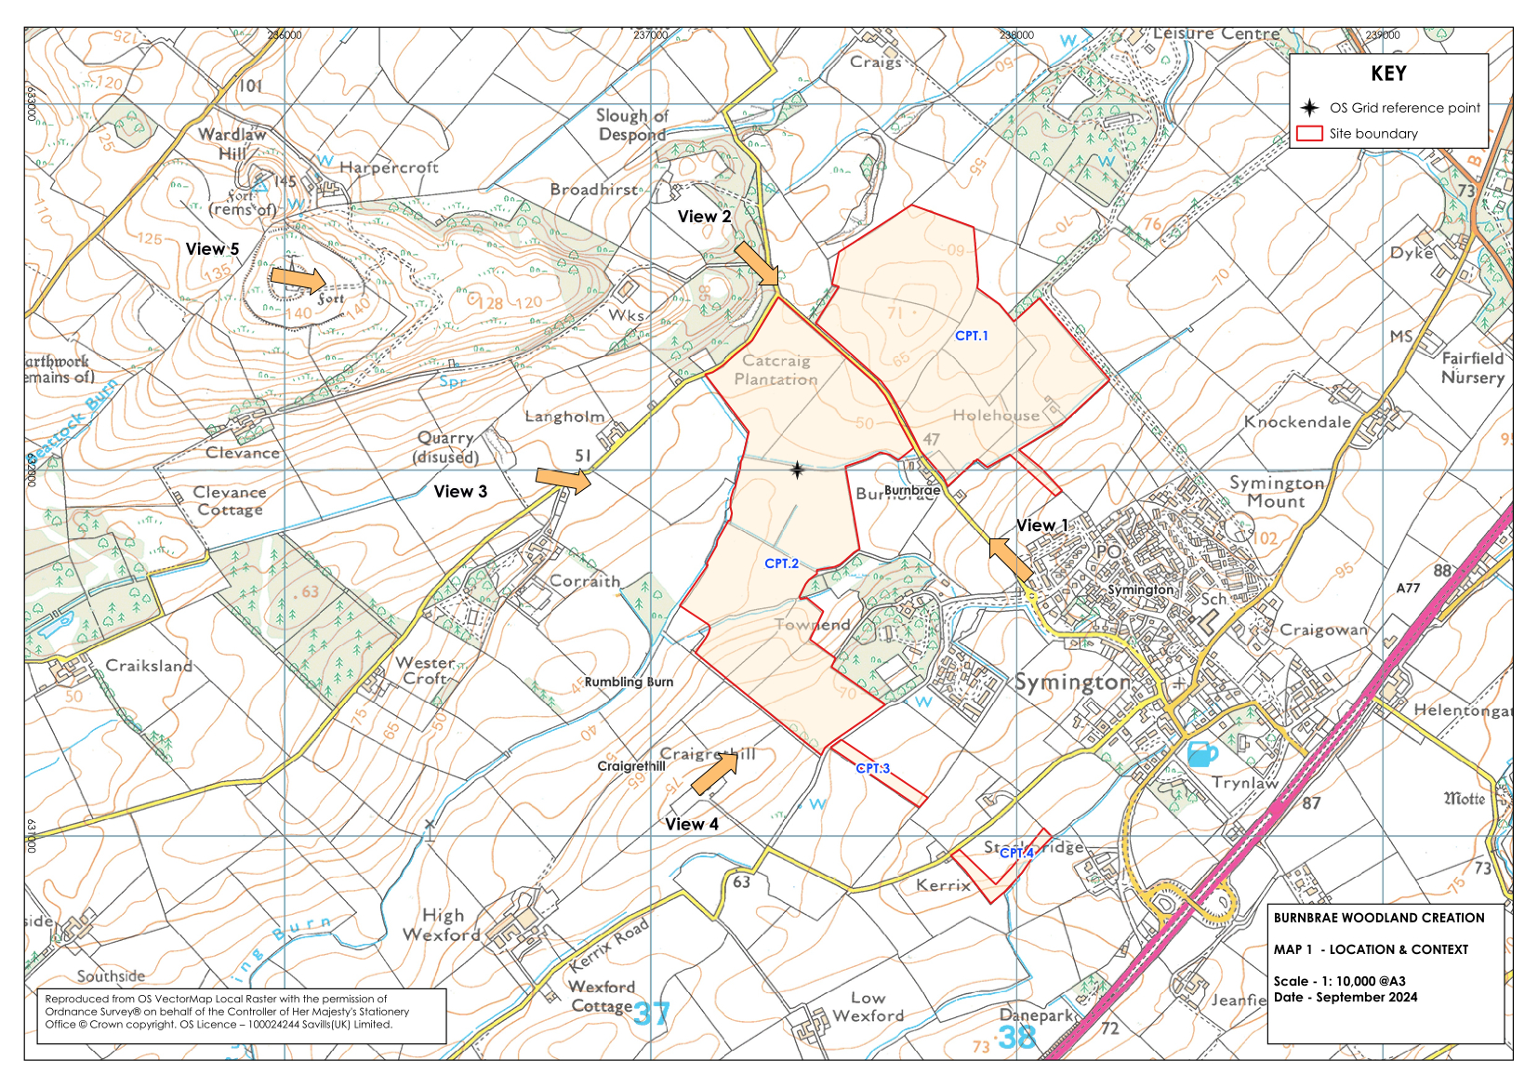
Burnbrae Woodland Creation Landscape Visualisations – Prospect Designer Location, Context and Viewpoints

Slide 9
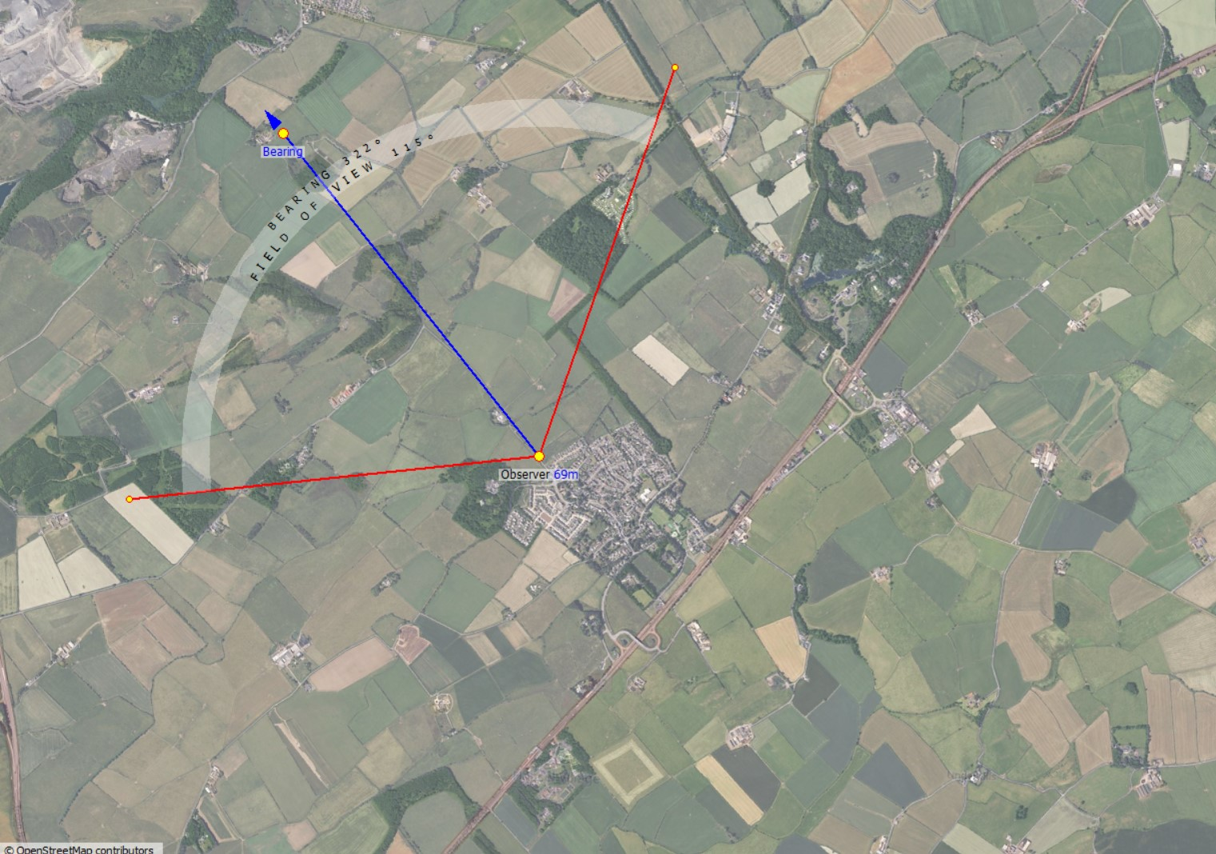
Burnbrae Woodland Creation Landscape Visualisations – Prospect Designer Viewpoint 1 – NS 380 318

Slide 10
Burnbrae Woodland Creation Landscape Visualisations – Prospect Designer Viewpoint 1 - Panorama
2024 - Current View
2065 - Visualisation

Slide 11
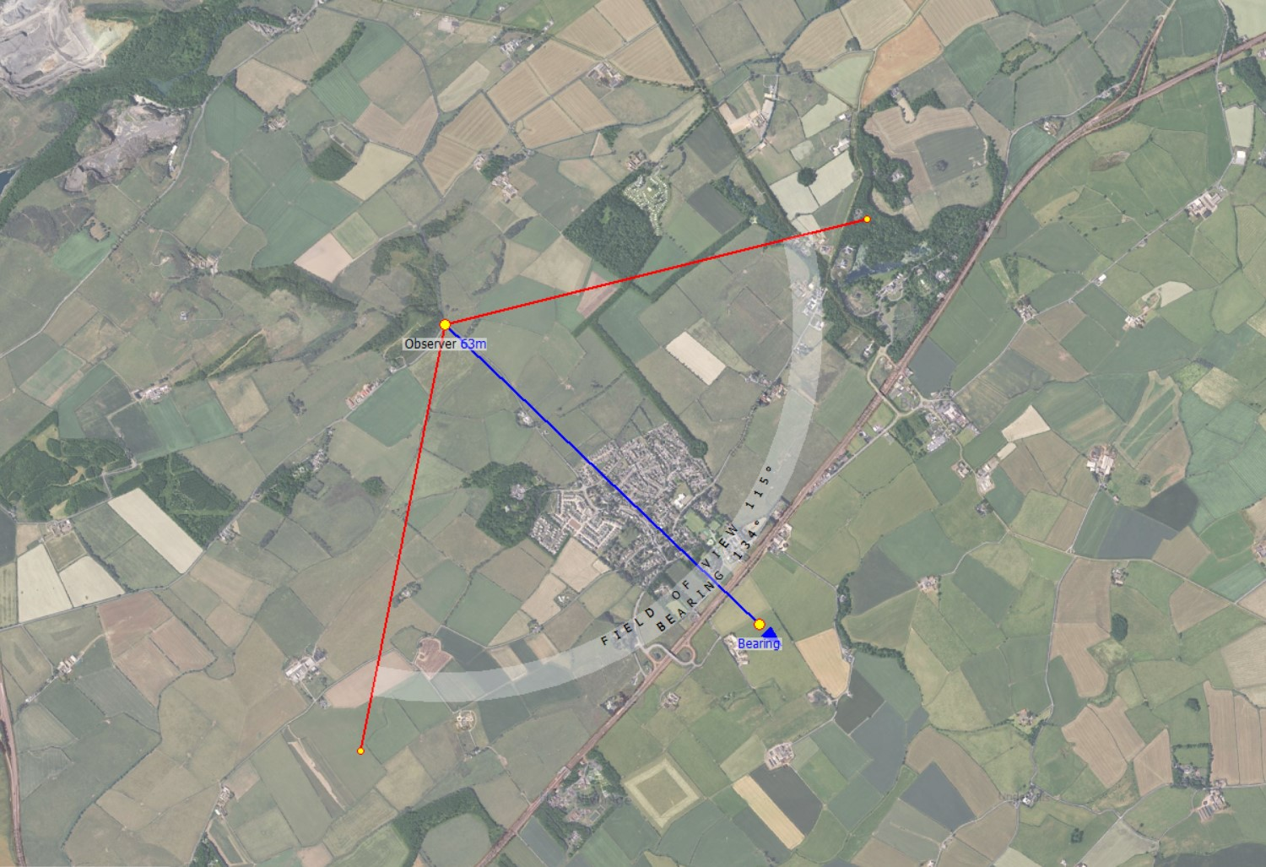
Burnbrae Woodland Creation Landscape Visualisations – Prospect Designer Viewpoint 2 – NS 373 325

Slide 12
Burnbrae Woodland Creation Landscape Visualisations – Prospect Designer Viewpoint 2 - Panorama
2024 - Current View
2065 – Visualisation

Slide 13
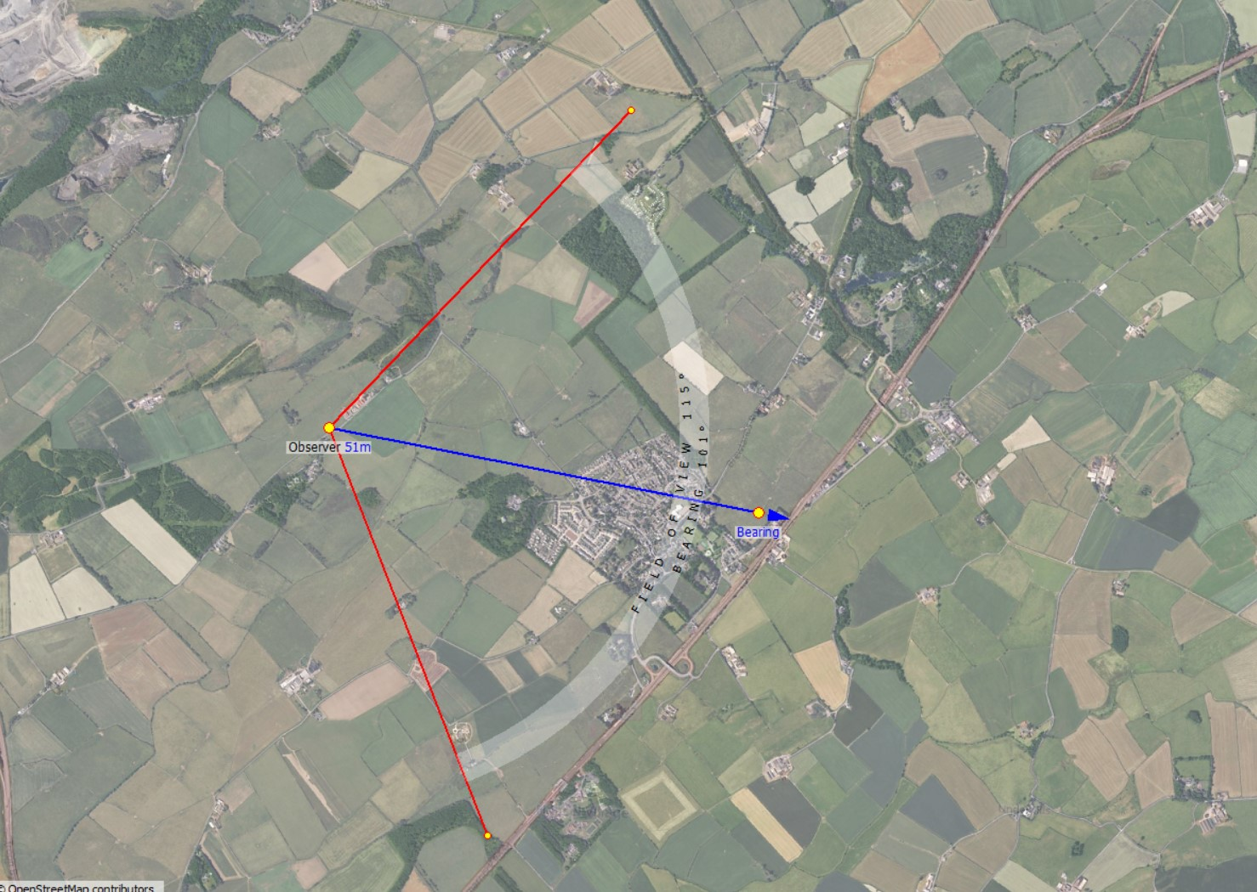
Burnbrae Woodland Creation Landscape Visualisations – Prospect Designer Viewpoint 3 – NS 368 320

Slide 14
Burnbrae Woodland Creation Landscape Visualisations – Prospect Designer Viewpoint 3 - Panorama
2024 - Current View
2065 – Visualisation

Slide 15
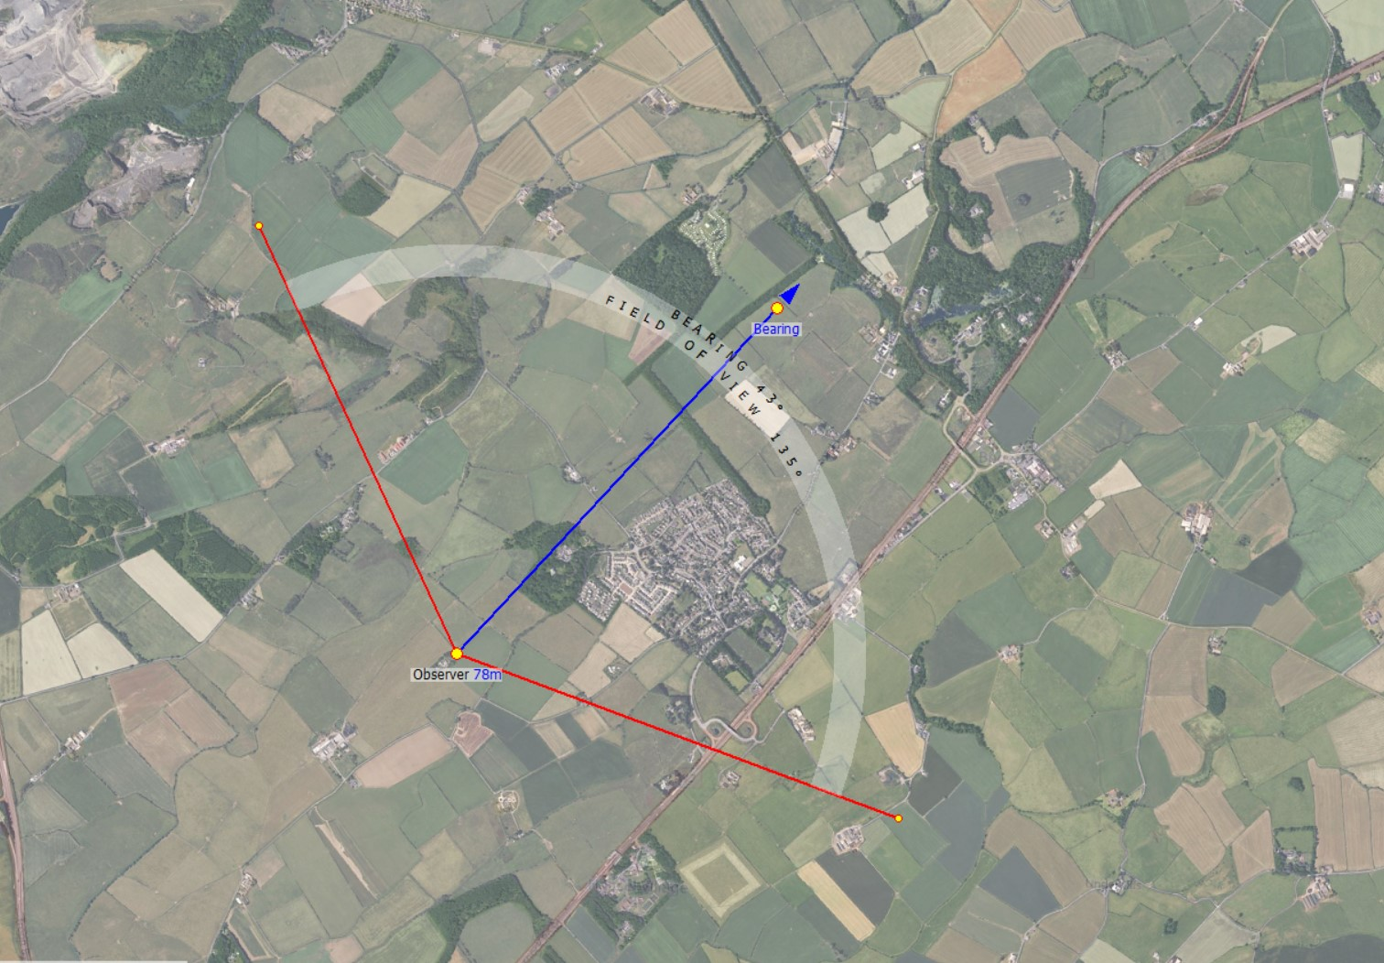
Burnbrae Woodland Creation Landscape Visualisations – Prospect Designer Viewpoint 4 – NS 367 309

Slide 16
Burnbrae Woodland Creation Landscape Visualisations – Prospect Designer Viewpoint 4 - Panorama
2024 - Current View
2065 – Visualisation

Slide 17
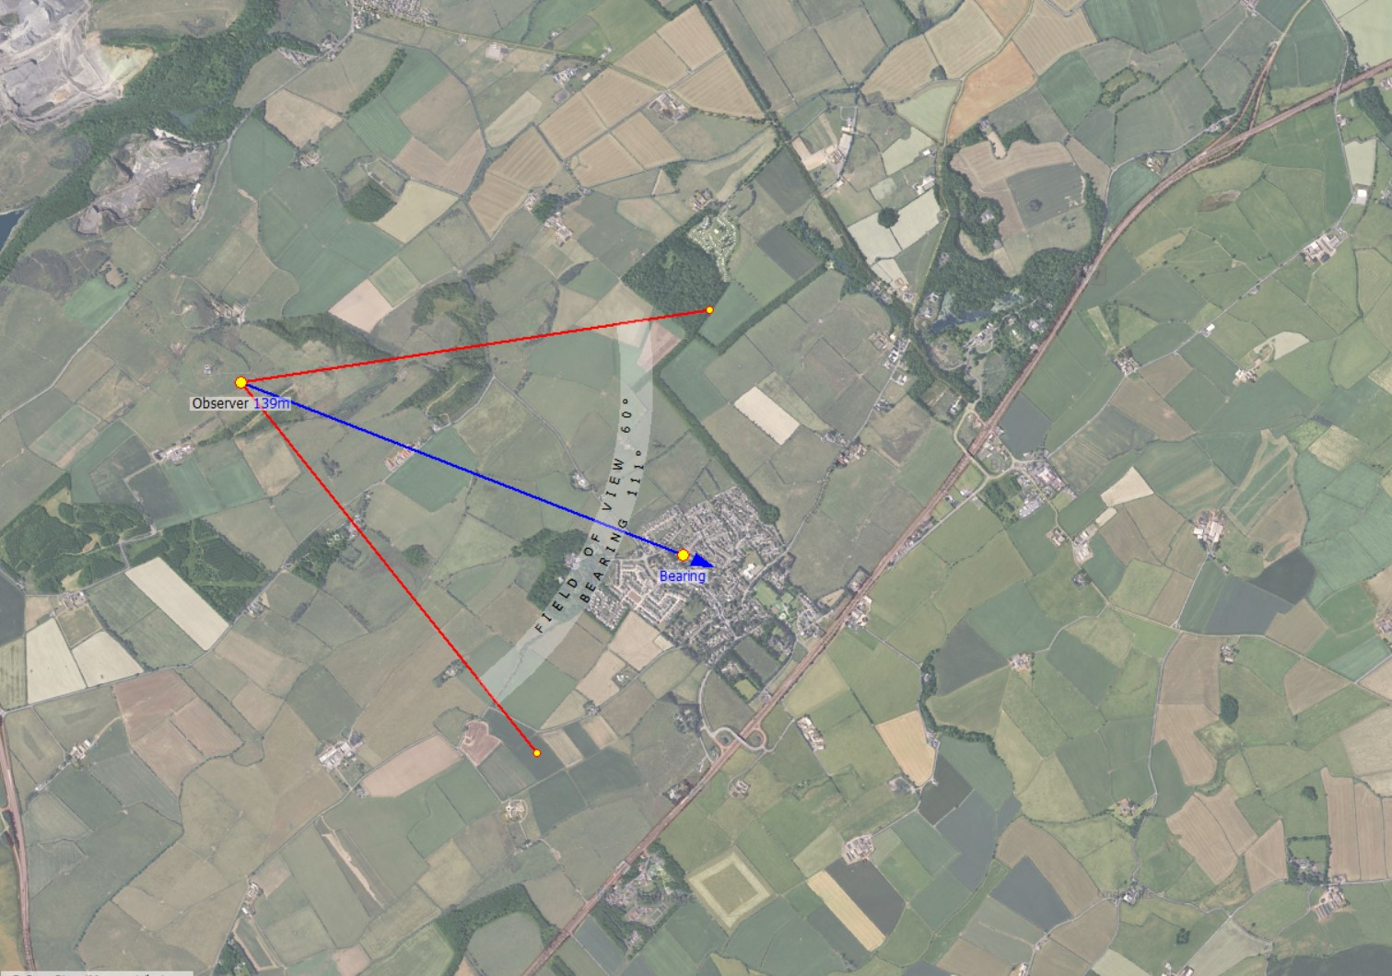
Burnbrae Woodland Creation Landscape Visualisations – Prospect Designer Viewpoint 5 – NS 362 325

Slide 18
Burnbrae Woodland Creation Landscape Visualisations – Prospect Designer Viewpoint 5 - Panorama
2024 - Current View
2065 – Visualisation

Slide 19
How to Comment
Your questions, comments and feedback on the proposals are welcome.
You can fill-in a feedback form and post it in the ‘Feedback Forms’ box provided or send it by post to Walker Hines Woodland Services at the address below.
The feedback form is also available on request by email.
Please also get in touch should you wish for further information.
Walker Hines Woodland Services
8 Kirkton Avenue, Bathgate, West Lothian, EH48 1EN
Email: mail@walkerhineswoodlandservices.co.uk
A note of all comments received will be passed on to Scottish Forestry, along with details of any design amendments proposed.
If you wish to copy Scottish Forestry into your correspondence, their contact details are:
Scottish Forestry
Central Scotland Conservancy, Bothwell House, Hamilton Business Park, Caird Park, Hamilton ML3 0QA Email: centralscotland.cons@forestrey.gov.scot

